Slide 1
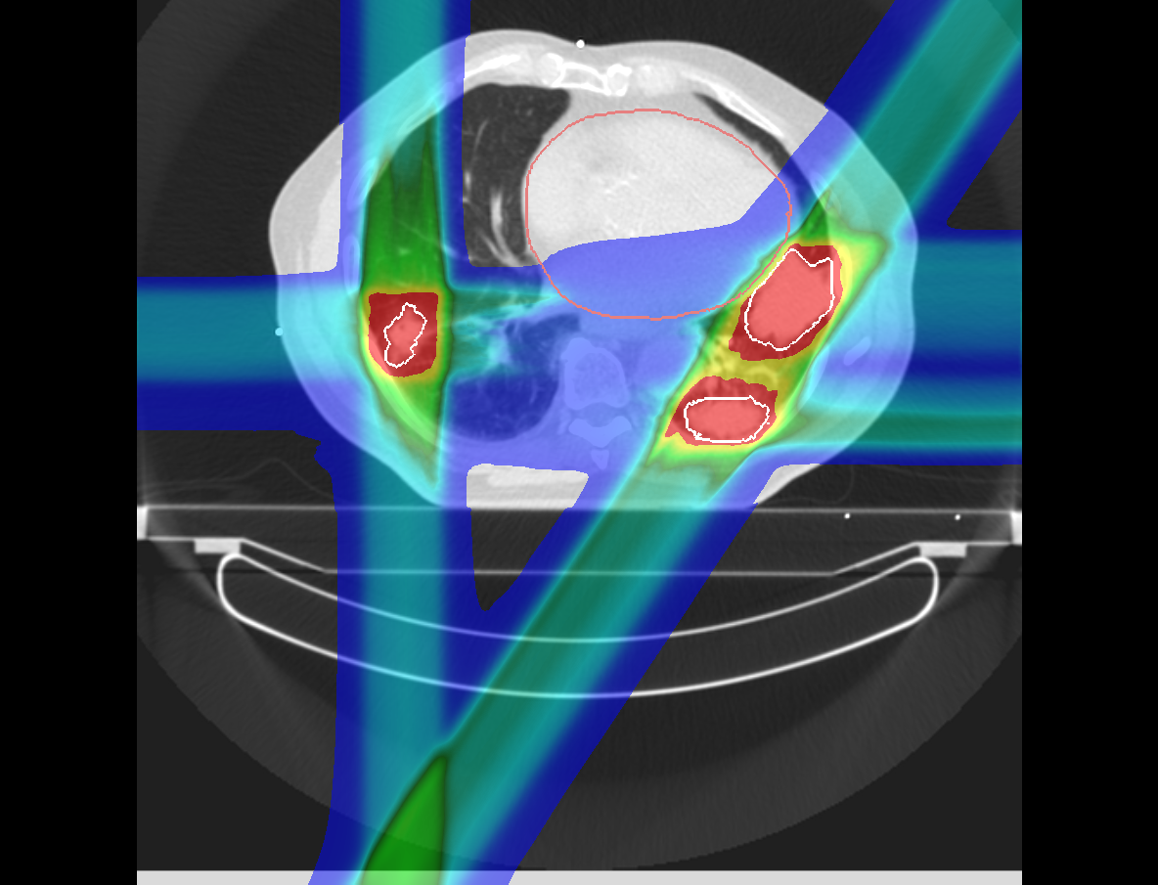
In Silico Comparison of Photons versus Carbon Ions in Single Fraction Therapy of Lung Cancer
Kristjan Anderle

Slide 2
Outline
Introduction
Lung Cancer
Lung Cancer Patients – Cohort 1
Lung Cancer Patients – Cohort 2
Conclusion & Outlook

Slide 3
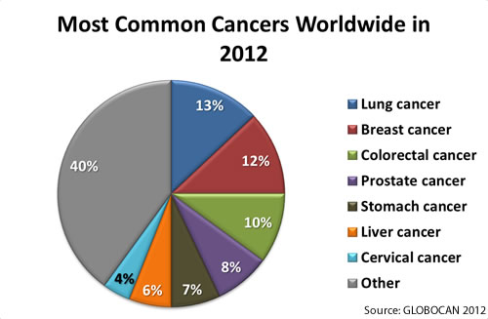
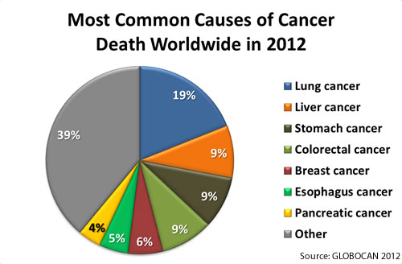
Introduction
Notes:
Let me begin by introducing you the motivation behind this PhD.

Slide 4
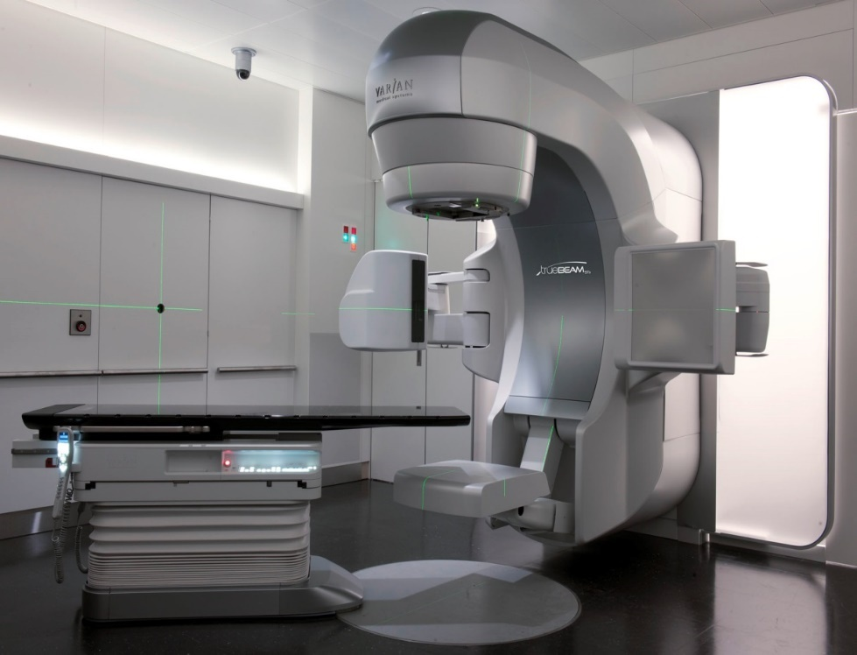

Stereotactic Body Radiation Treatment (SBRT)
High precision treatment with photons
Delivers high dose (up to 30 Gy) in few fractions (1-3)
Good results for lung cancer in early stages
Limited for:
Multiple tumors
Large tumors
Notes:
State of the art radiotherapy for lung cancer is call SBRT.

Slide 5
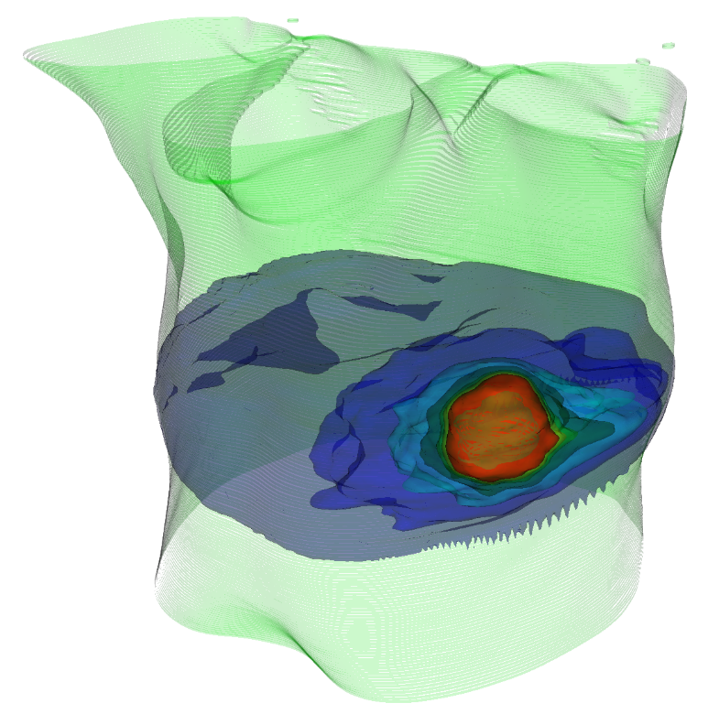
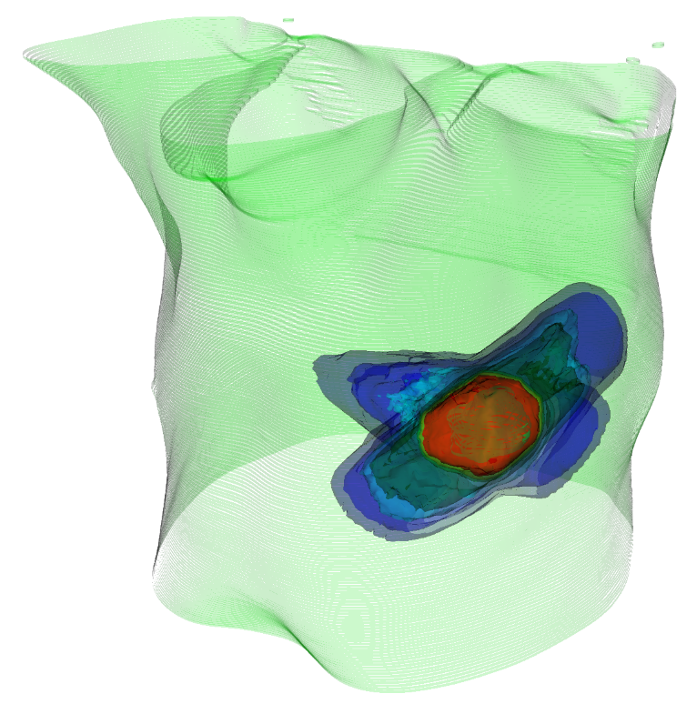
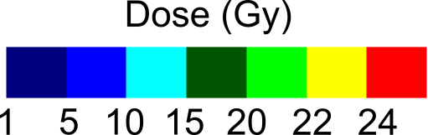
3D Treatment Plan Example
Photons
¹²C
Notes:
A possible alternative to SBRT could be carbon-ion therapy.

Slide 6
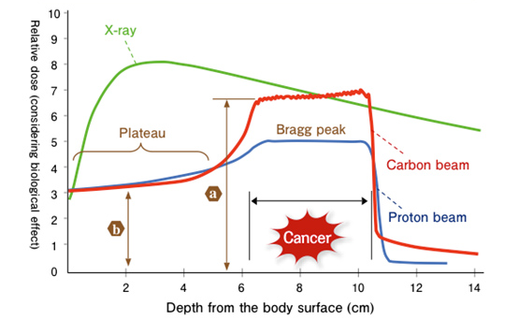
Particle Therapy
Advantageous dose profile for radiotherapy
Bragg peak depends on particle energy
No or small dose tail after the Bragg peak
Currently, mostly static targets are treated (head & neck, prostate)
Source:NIRS,2016
Notes:
The reason carbon-ions could be alternative is in their dose deposition.

Slide 7
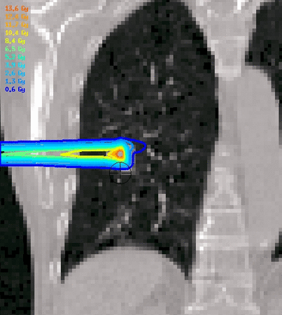
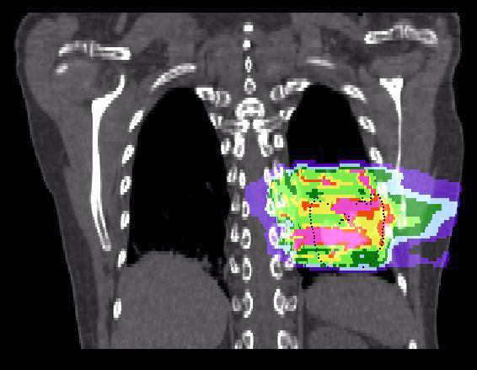
Motion Effects in Particle Therapy
Range Changes
Interplay
Courtesy M. Söhn, LMU
Courtesy C. Graeff, GSI
Notes:
Treatment centers treat mostly static cases, because treatment of moving tumors introduces uncertaneties.

Slide 8
Motion Effects in Particle Therapy
Range Changes
Interplay
Courtesy M. Söhn, LMU
Courtesy C. Graeff, GSI
Compensations:
Include range-changes in target definition (range ITV)
Optimization in all motion states
(4D-optimization)
Rescanning: instead of delivering the whole dose at once, it is delivered in N steps

Slide 9
In Silico Study
Comparison of lung cancer treatment simulations between SBRT and active scanning carbon-ions (PT)
23 lung cancer patients were actually treated with SBRT
Comparison:
Dose to the tumor
Dose to critical organs
Dose escalation
Notes:
To evaluate potential of carbon ions, we compared treatment plans for lung cancer patients between SBRT and carbon ions.

Slide 10
Treatment planning – Cohort I
19 patients, 26 tumors
Planning objectives:
Single fraction of 24 Gy
Tumor D_{99%} > 100%
Critical organs limits
Single field uniform optimization with range ITV
10 dose calculations per patient:
Without motion, static (2x)
With motion, without compensation, 4D-interplay (4x)
With motion, with compensation, 4D-rescanning (4x)
Notes:
Our study began with comparing treatment plans for 19 patients with 26 tumors.

Slide 11
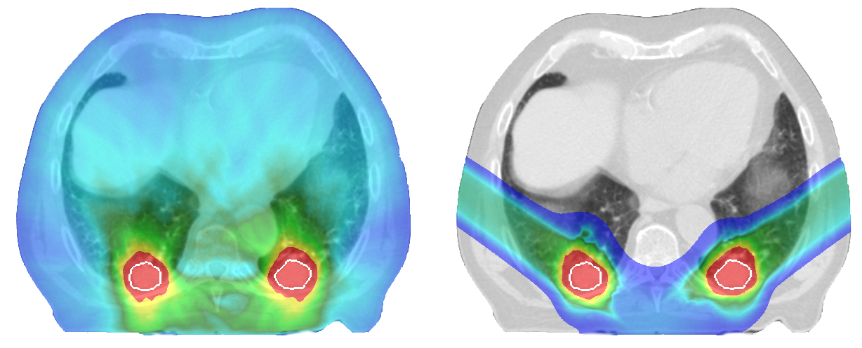
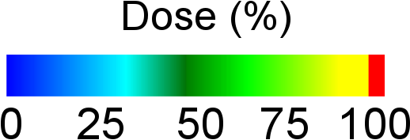
Treatment Plan Examples
SBRT
PT
Notes:
Let me show you two examples. First is a patient with two tumors in the back of both lung wings.

Slide 12
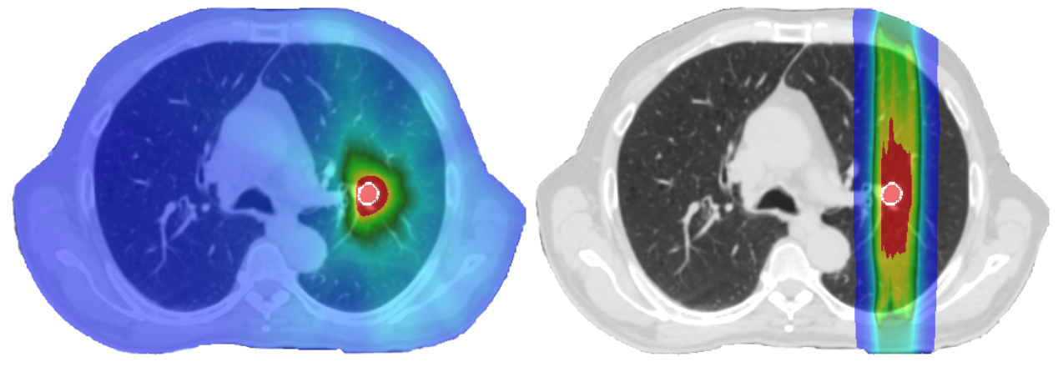
Treatment Plan Examples
SBRT
PT
Notes:
Second is a patient with a small tumor in a central position.

Slide 13
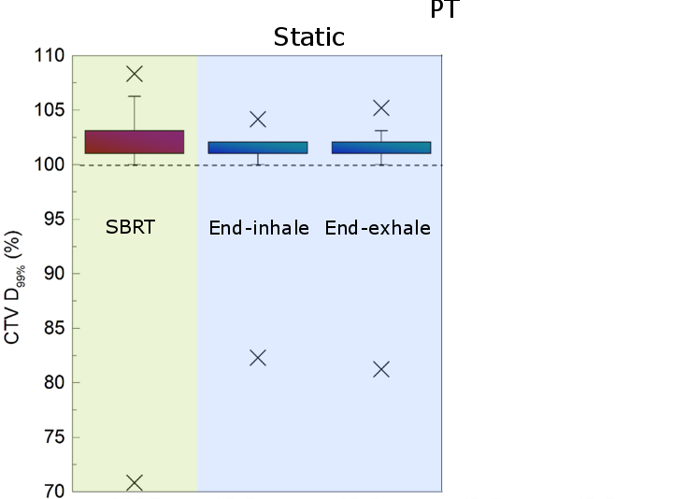
Results – Dose to Tumors
No difference in tumor dose between SBRT and static PT (3D)
Notes:
As mentioned the planning objective was, 99% of the tumor volume has to recieve more than 100 % of the planned dose.

Slide 14
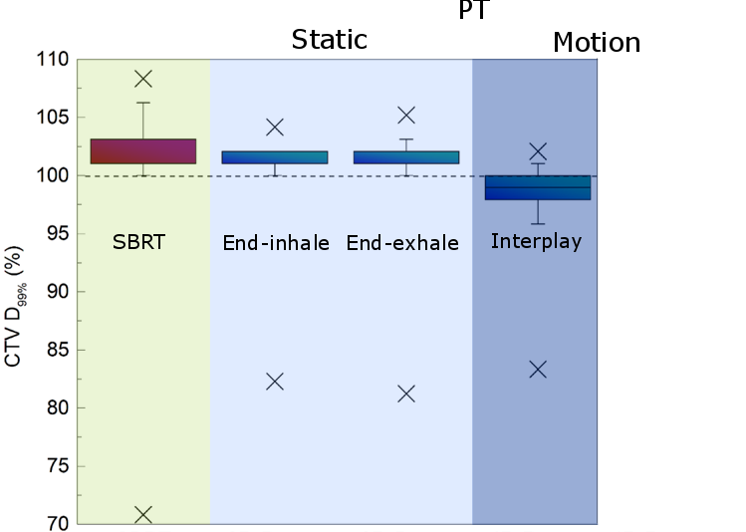
Results – Dose to Tumors
No difference in tumor dose between SBRT and static PT (3D)
Without motion compensation the tumor dose is too low (4D interplay)

Slide 15
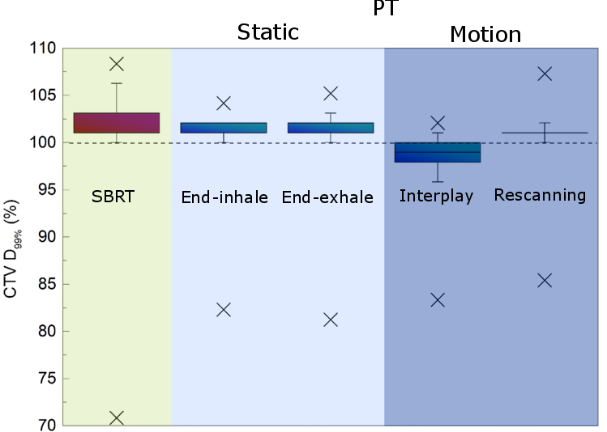
Results – Dose to Tumors
No difference in tumor dose between SBRT and static PT (3D)
Without motion compensation the tumor dose is too low (4D interplay)
Rescanning mitigates tumor motion sufficiently (4D rescan)

Slide 16
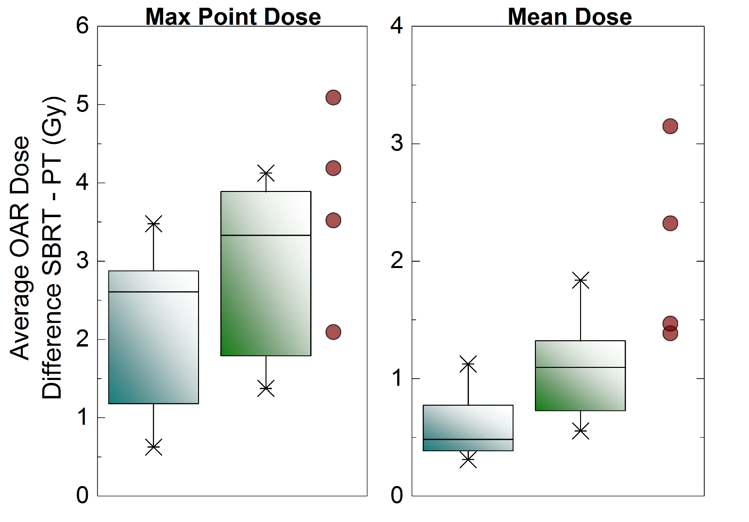
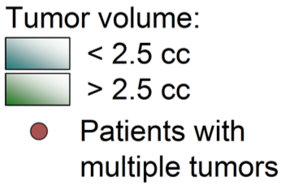
Results - Dose to Critical Organs
Notes:
We compared dose to critical organs with two different dose metrics.0

Slide 17
Clinical Trial RTOG 0617
A RTOG 0617 trial compared 60 Gy and 74 Gy dose to tumors
In contrast to inital hypothesis, higher dose led to higher mortality
The only significant difference between two groups was dose to the heart (V5)
(Bradley, JD et al, Lancet Oncology, 2015)
Notes:
Especially important may be dose to the heart.

Slide 18
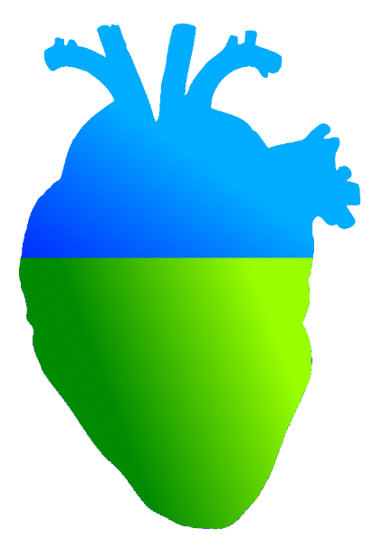
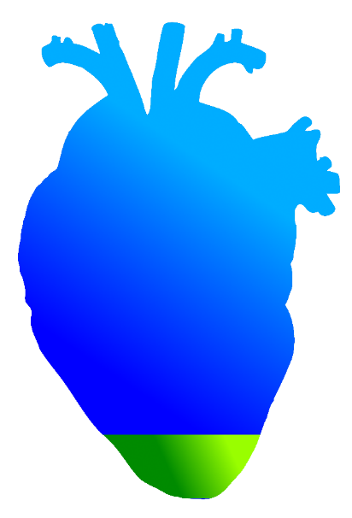
Average Heart V5
SBRT
PT
55%
Volume receiving 5% dose (1.2 Gy)
7.6%
Notes:
If we take a look at Heart V5 for SBRT and carbon ions, the difference is substantial.

Slide 19
Treatment planning – Cohort II
8 patients, 24 tumors
Different fractionation schemes
3 tumors in 2 patients received 3 x 9 Gy
2 tumors received 1 x 20 Gy
1 tumor received 1 x 22 Gy
1 tumor received 5 x 7 Gy
All others 1 x 24 Gy
Intensity modulated particle therapy optimization with rescanning
Range ITV
4D-optimization
Notes:
As we‘ve seen, patients with multiple tumors, may especially benefit from carbon ion therapy.

Slide 20
Treatment planning – Cohort II
8 patients, 24 tumors
Different fractionation schemes
3 tumors in 2 patients received 3 x 9 Gy
2 tumors received 1 x 20 Gy
1 tumor received 1 x 22 Gy
1 tumor received 5 x 7 Gy
All others 1 x 24 Gy
Intensity modulated particle therapy optimization with rescanning
Range ITV
4D-optimization
Dose ecalation to 1 x 24 Gy

Slide 21
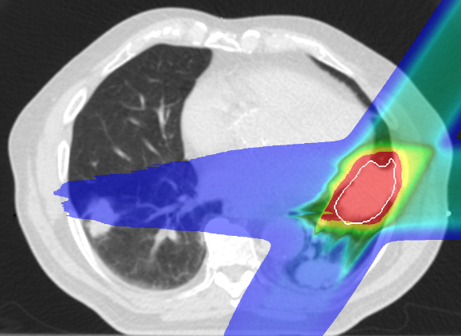
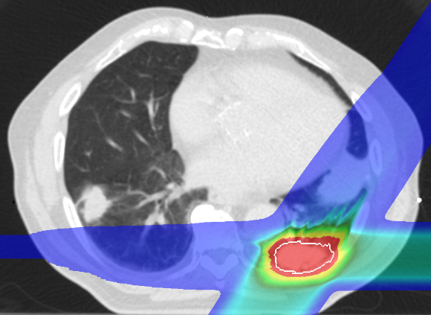
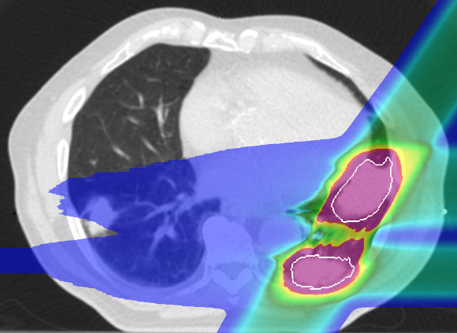
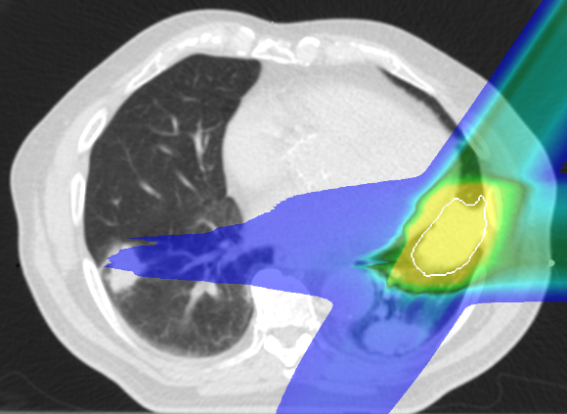
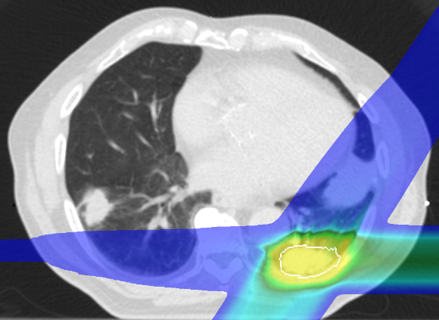
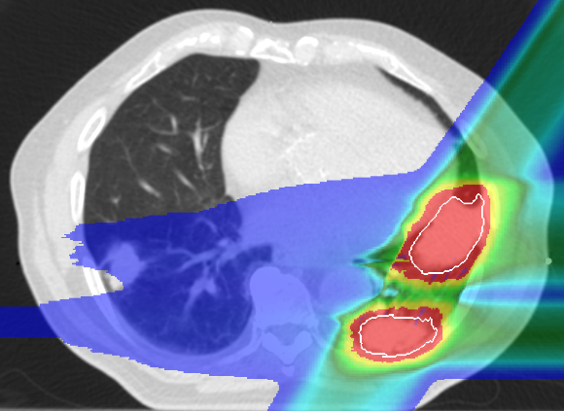
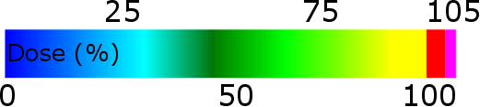
Intensity Modulated Particle Therapy Optimization for Multiple Targets
Target 1
Target 2
Target 1 & 2
Each target optimized
individually:
Targets optimized
simultaneously:
Notes:
Treatment planning software that we used was not able to handle mutliple targets optimization.

Slide 22
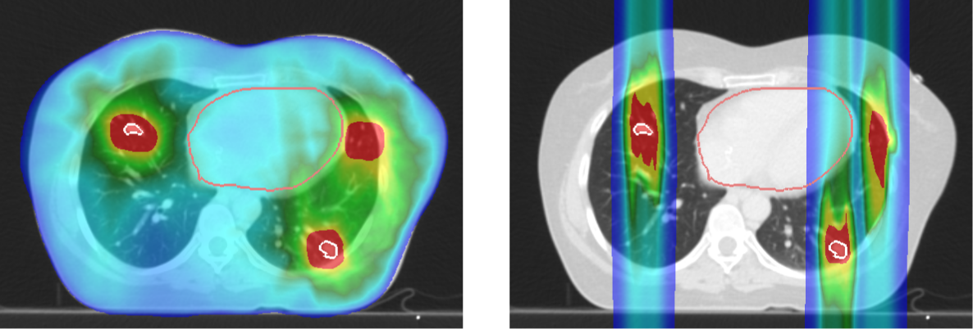
Treatment Plan Examples
SBRT
PT
All 5 targets received planned dose with SBRT and PT (CTV D_{99%} > 100 %)
Notes:
Let me show you two examples from second cohort. First is a patietnt..

Slide 23
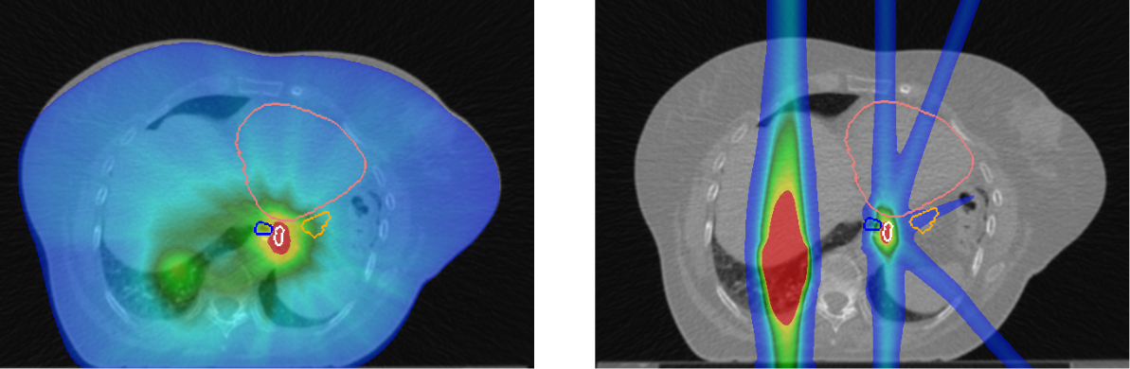
Treatment Plan Examples
Heart
Heart
Esophagus
Stomach
Esophagus
Stomach
Target
Target
SBRT
PT
Planning dose not met with PT
(SBRT D_{99%} = 100%, PT D_{99%} = 75%)
Notes:
Except for this patient, which had a very small tumor, around half of cubic centimiter.

Slide 24
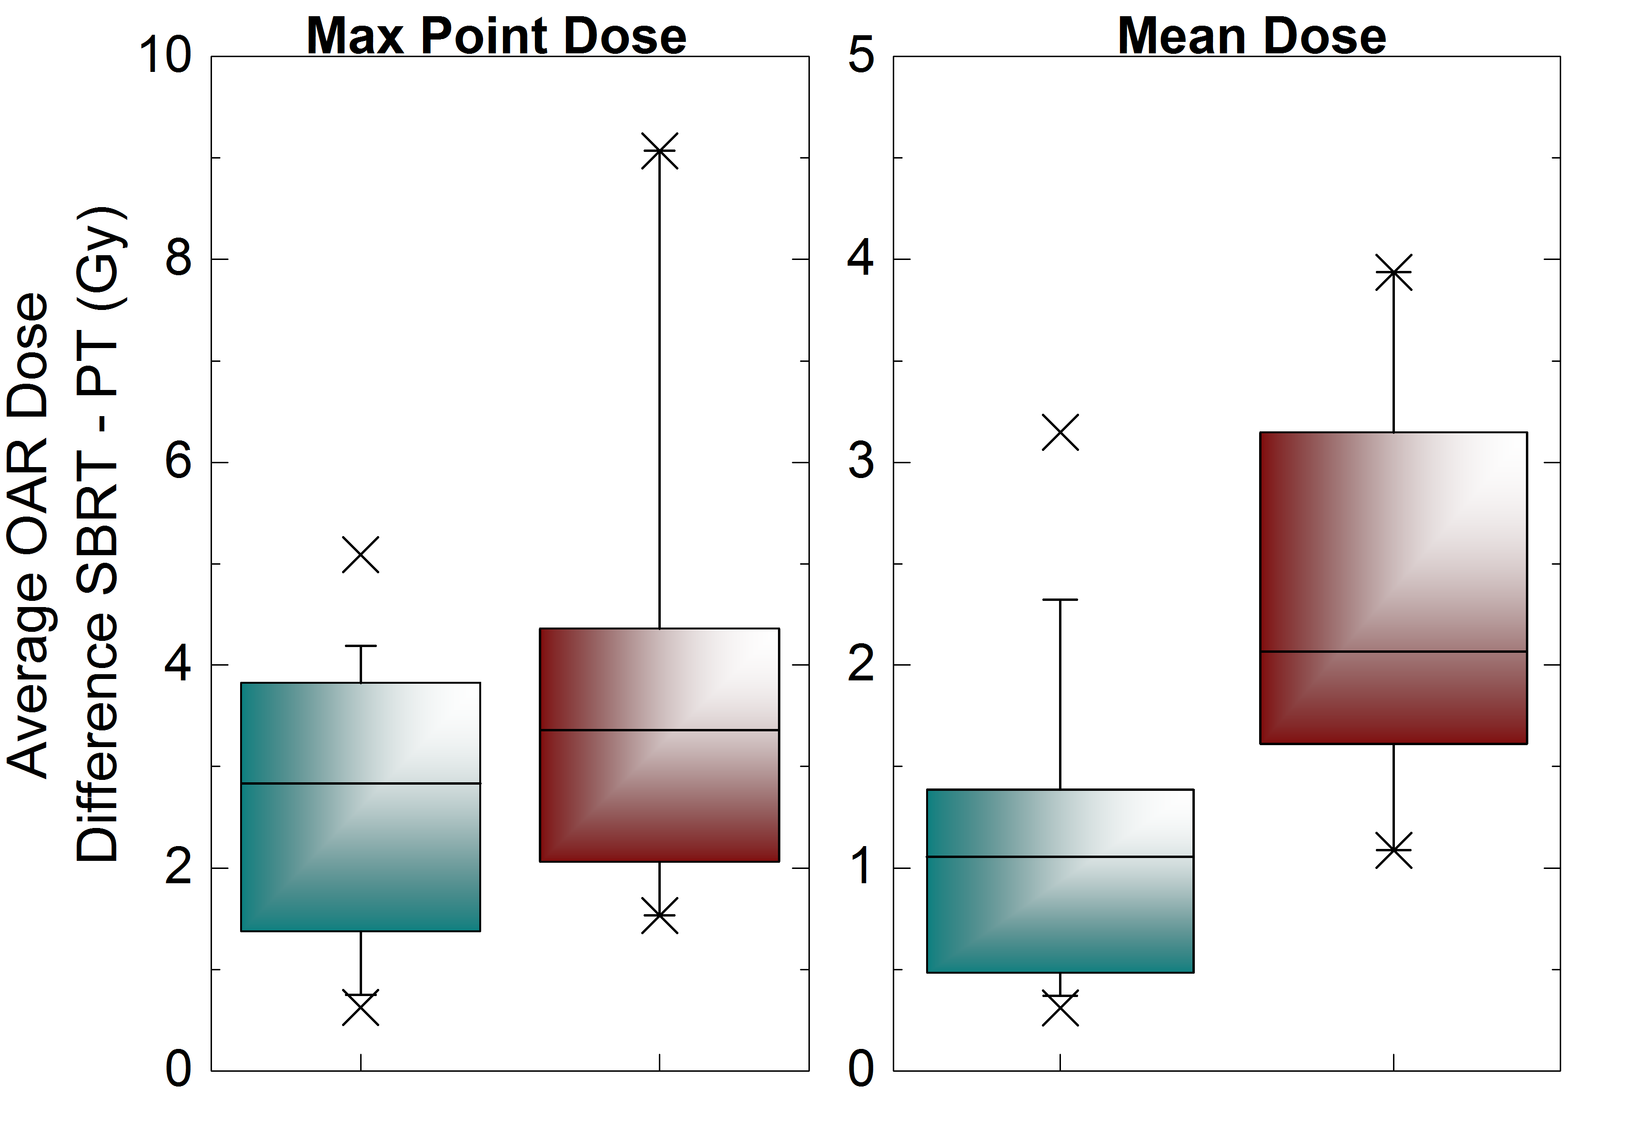
Results – Dose to Critical Organs
Cohort I
Cohort II
Cohort I
Cohort II
Notes:
Here we have difference between SBRT and carbon-ion dose to critical organs and the results from previous cohort are ploted alongside the second one.

Slide 25
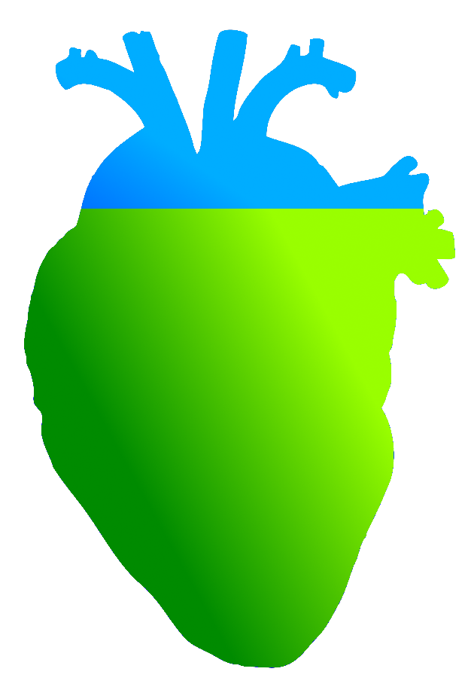
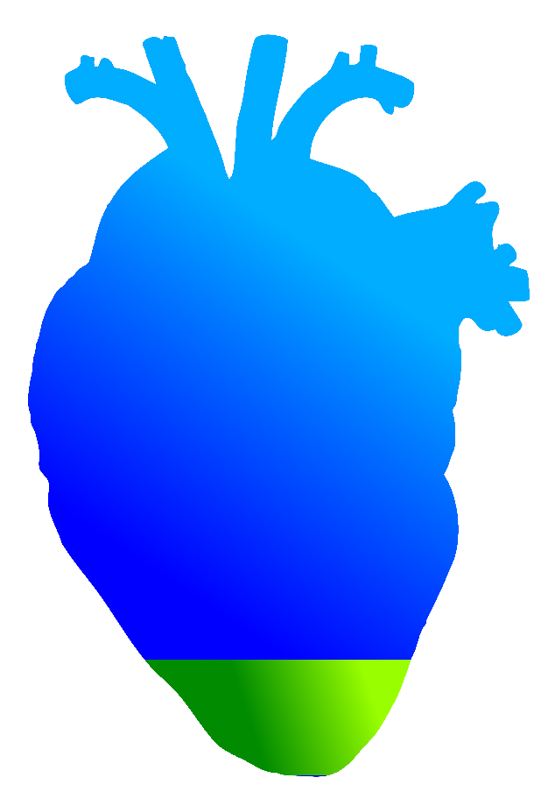
Average Heart V5
SBRT
PT
81 %
8.7%
Notes:
A significant difference is in heart V5, which as we mentioned could be of extreme importance.

Slide 26
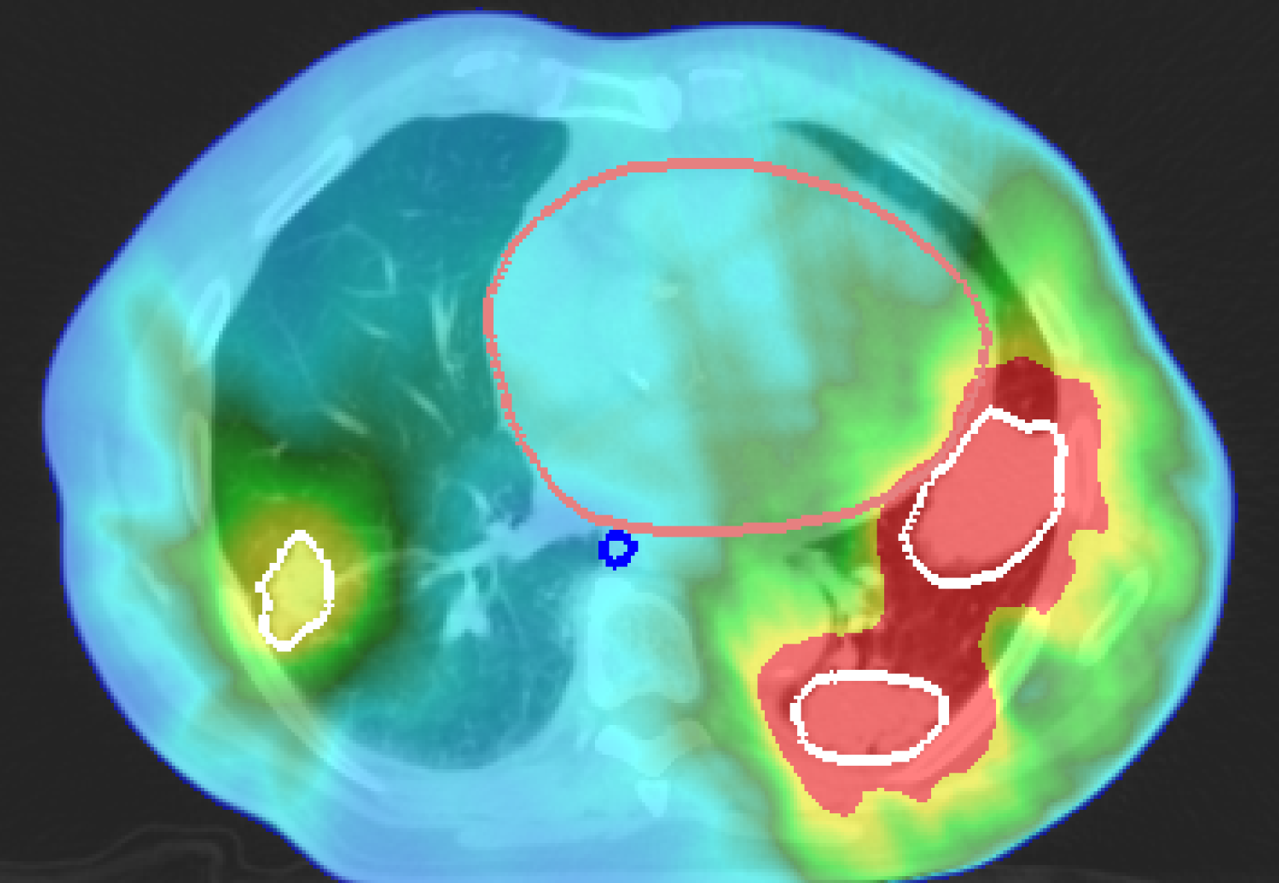
Results – Dose Escalation
1 tumor: 1 x 22 Gy
2 tumors: 1 x 21 Gy
2 tumors: 3 x 9 Gy
5 tumors: 1 x 24 Gy
Notes:
A dose escalation was possible with carbon ions for the patient you can see on the slide. There were five lung tumors and SBRT was limited due to the excesive heart dose and it had to employ a complex fractionation scheme, as displayed. With carbon ions it was possible to delive single dose of 24 Gy to all targets, without exposing heart to too much dose.

Slide 27
Heart Dose Volume Histogram
Notes:
In fact, if we look at dose volume histogram for the heart, the difference between SBRT and carbon-ions is apparent.

Slide 28
Conclusions
PT delivers the same dose to tumors as SBRT,
while depositing significantly less dose to normal tissue
PT could deliver full ablative dose in single fraction, where SBRT could not
Patient selection for PT:
Multiple targets
Large tumors
Small tumors with large motions
Notes:
To conclude, carbon-ions delivere the same dose to tumors, while depositing less dose to normal tissue.

Slide 29

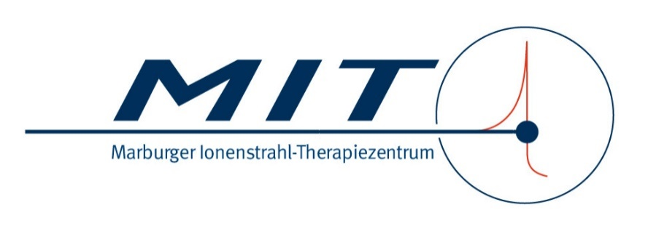
Outlook
First lung cancer patients treated with active scanning carbon-ions at NIRS, Chiba (Japan)
As part of the LOEWE grant, results from this study will be used for actual lung cancer treatment at MIT – especially the multiple target case.
Notes:
There are first patients being treatet at NIRS in Japan.

Slide 30

Acknowledgments
GSI
C. Graeff
M. Durante
A. Eichhorn M. Prall
S. Hild
FC
J. Stroom
C. Greco
N. Pimentel
S. Vierra
UK Erlangen
C. Bert
T. Brandt
J. Wölfelschneider

